Slide 1
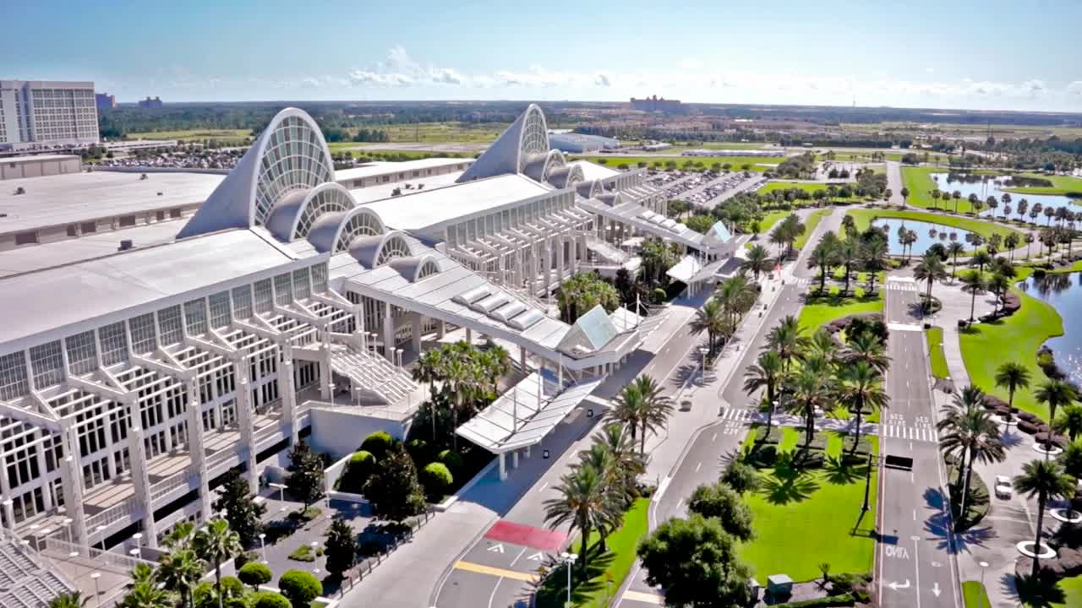
Orange County Convention Center Overview
September 29, 2026

Slide 2

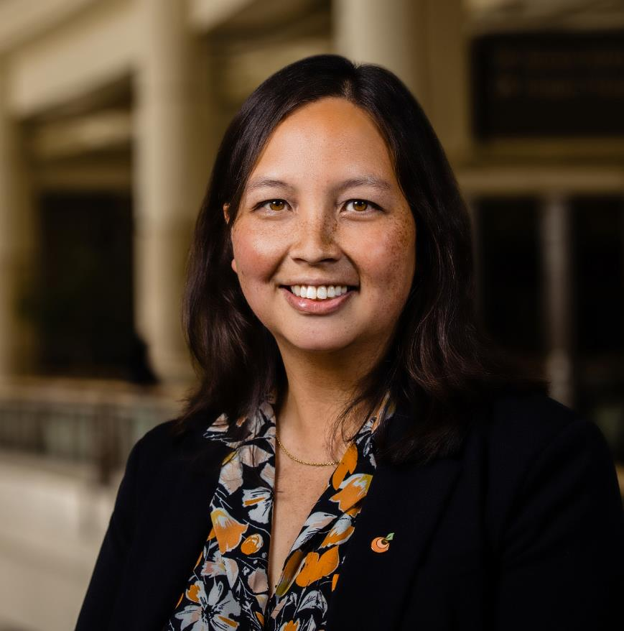
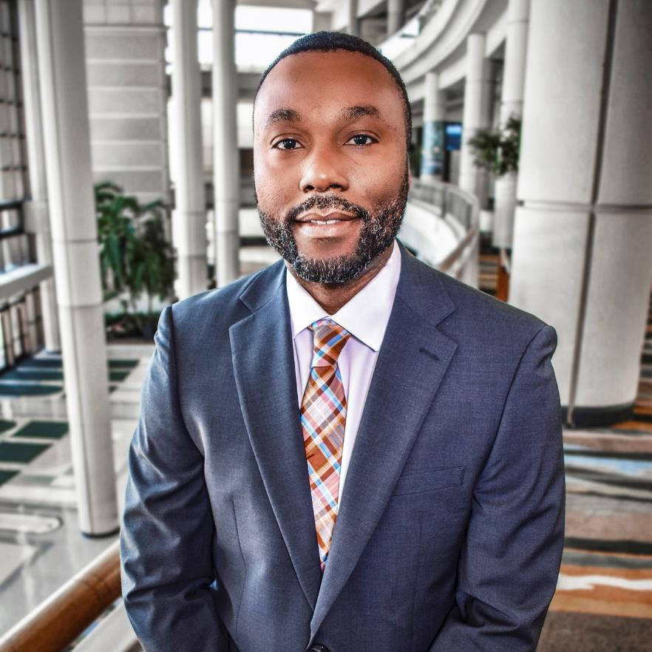
Introductions
Crystal Mudd
CAPITAL PLANNING MANAGER
ORANGE COUNTY CONVENTION CENTER
Jeremiah Jones
CAPITAL PLANNING ASSISTANT MANAGER
ORANGE COUNTY CONVENTION CENTER

Slide 3

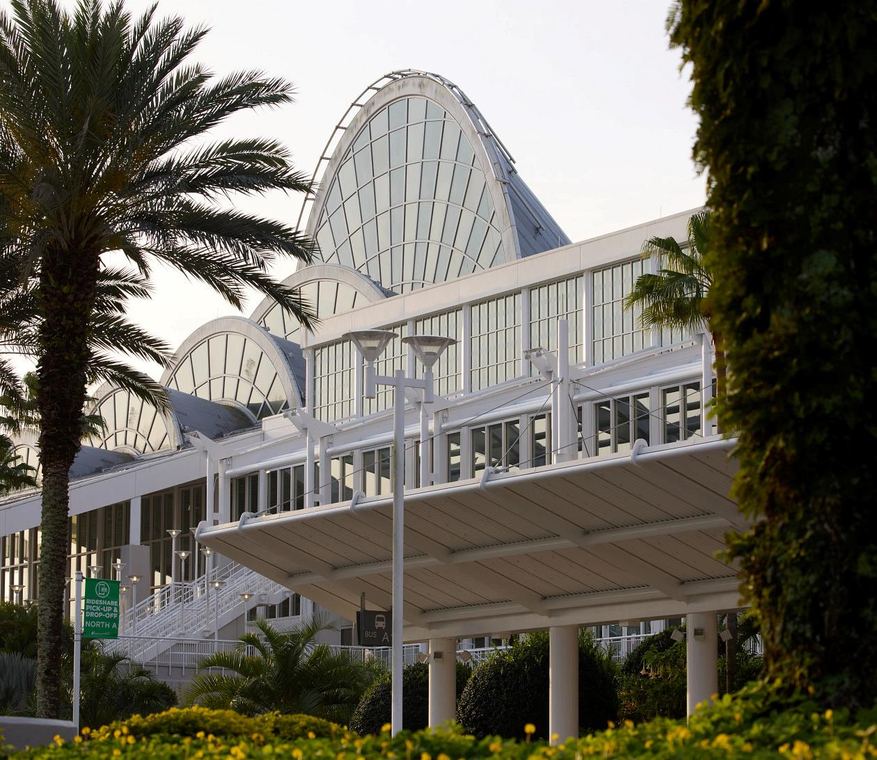
Vision | Mission | Values
Vision
Orange County to have the healthiest and most robust economy in the nation.
Mission
Our mission is economic development. By hosting conventions, trade shows, sporting events and more, the Center stimulates and infuses the local economy with new money and expanding business opportunities through world-class facilities and innovative services.
Values
As The Center of Hospitality, we are customer-service focused, relationship-driven and innovative. We are actively engaged with employees, clients and stakeholders.
Notes:
Vision – Our vision is for Orange County to have the healthiest and most robust economy in the nation.
Mission – Our mission is economic development. By hosting conventions and events, the Center stimulates and infuses the local economy with new money and expanding business opportunities through world-class facilities and innovative services.
Values – As The Center of Hospitality, we are customer-service focused, relationship-driven and innovative. We are actively engaged with employees, clients and stakeholders.
With our vision, mission and values in mind, I’d like to share why we exist with this video that was produced by our marketing and communications team.

Slide 4
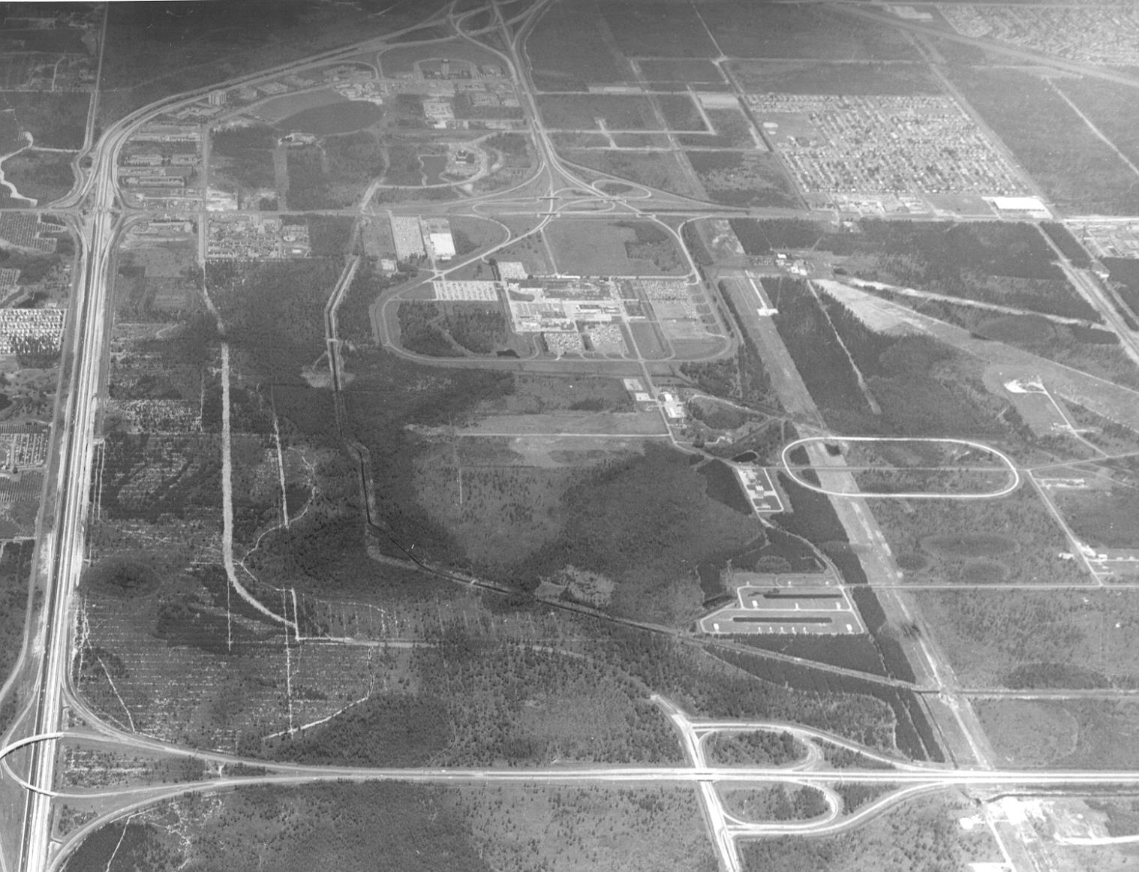
OCCC History
1983 Statistics
Metro Orlando Population: 900,000
Orlando International Airport (MCO) Passenger Volume: 8 Million
Area Theme Park: 3
Metro Orlando Hotel Rooms: 38,000
International Drive Area:
  2 Hotels
  1,800 Rooms
Notes:
When the Orange County Convention Center (OCCC) opened in 1983, the Central Florida area was
considerably less developed and in it’s infancy as a tourism destination. This was apparent in the
International Drive area, which at the time offered only two hotels, the Marriott International Drive and
the Sheraton World, with a combined 1,800 rooms.
This aerial view is from 1978, five years prior to the construction of the OCCC’s first building.
Provide an overview of Convention Center division role with the County.

Slide 5
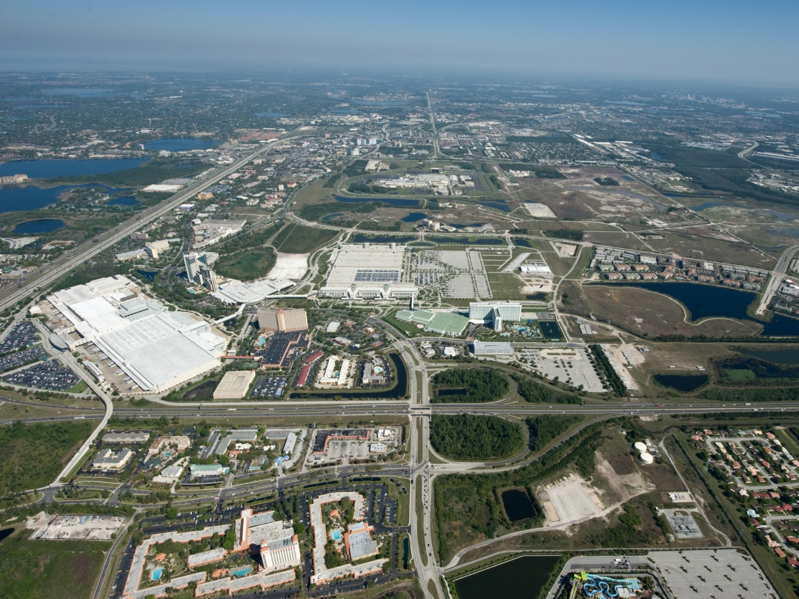
OCCC History
2022 Statistics
Metro Orlando Population: 2.7 million
OIA Passenger Volume: 50 million
Area Theme Parks: 7+
Metro Orlando Hotel Rooms: 120,000
Hotels within one mile of the OCCC:
  11+ hotels
  7,380+ rooms
Notes:
Today, the area has become a tourism Mecca. Hotel rooms have more than tripled and with the completion
of the Gary Sain Memorial Bridge, OCCC guests will have access to more than 5,200 hotel rooms via
pedestrian bridges alone.
The Orlando MSA has also seen considerable development in terms of attractions, air traffic and related
infrastructure – Orlando International Airport is the 13th busiest airport in the country. With 2.7 million
residents, Orlando is the third largest Metro area in the state, trailing only Miami/Ft. Lauderdale and
Tampa/St. Pete.
Built in multiple phases: I, II, IIA, III, IV, V
Phase V opened in 2003
7.1 Million square feet under roof
Pedestrian bridges connecting OCCC to nearby hotels
40th Anniversary celebrated in 2023

Slide 6
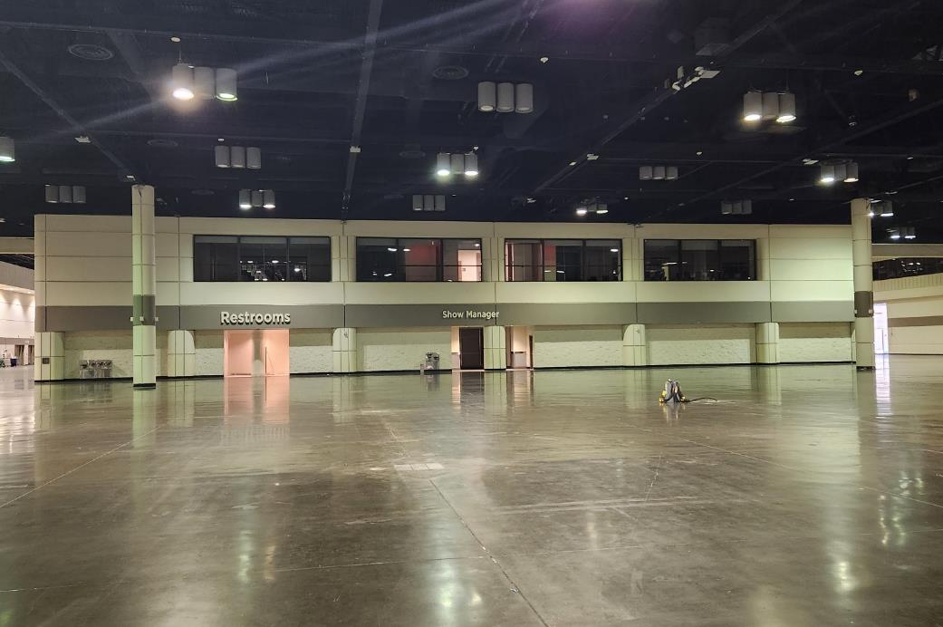
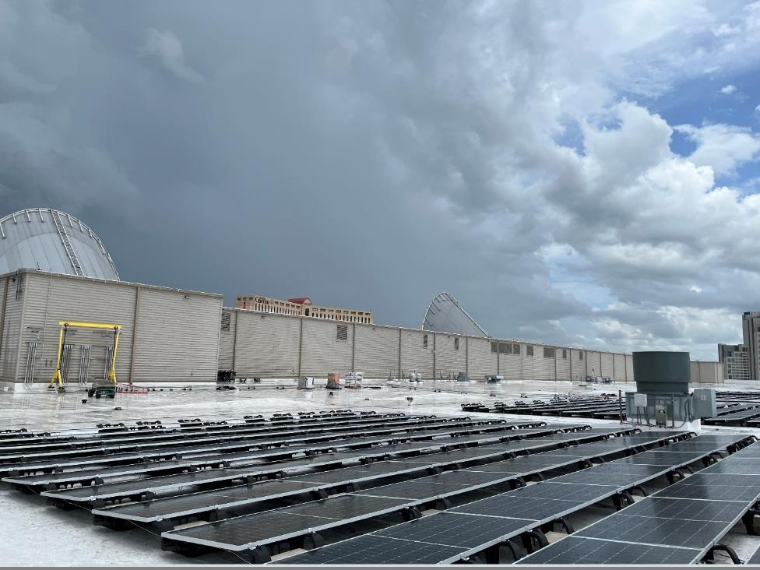
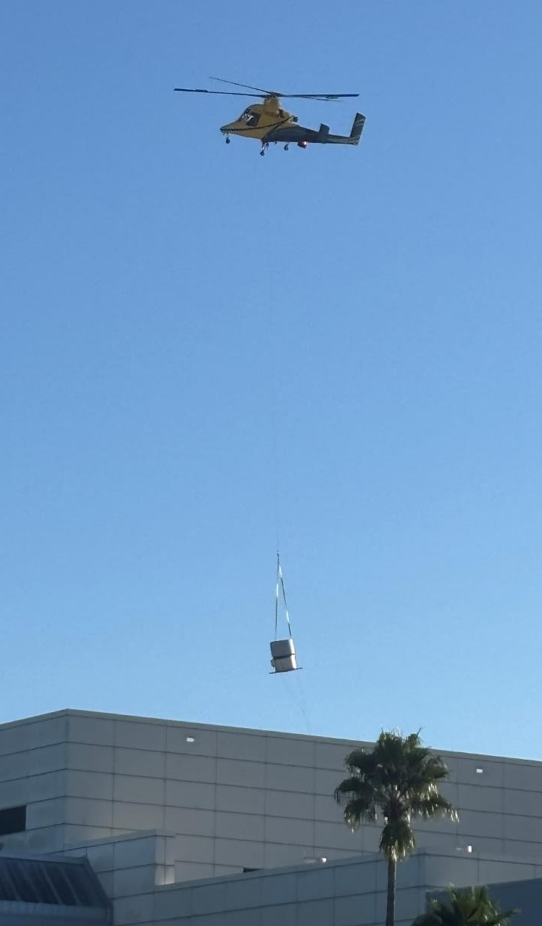

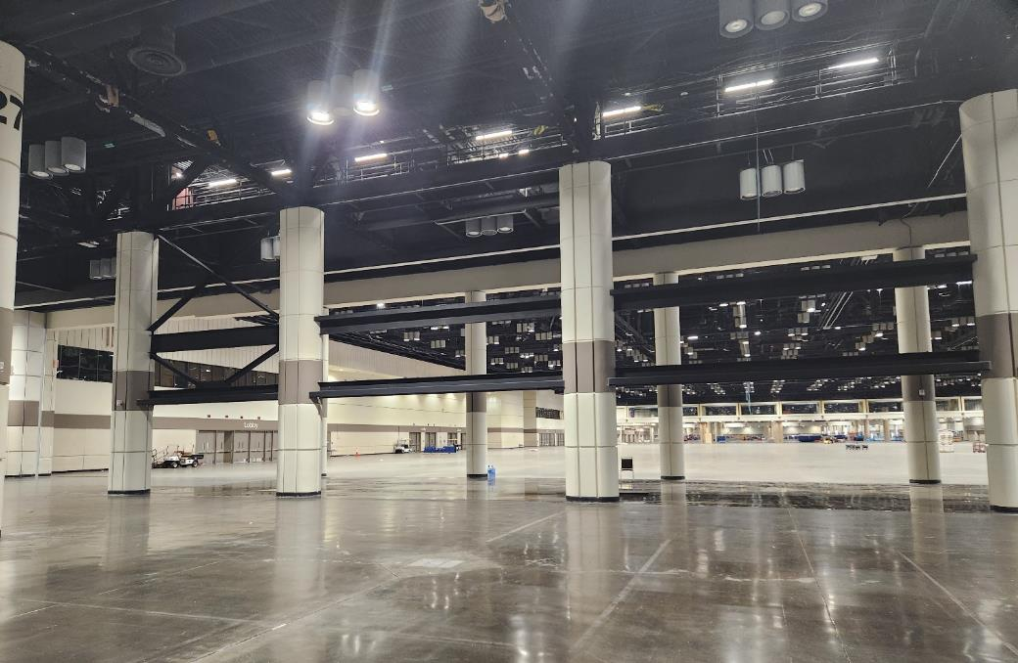
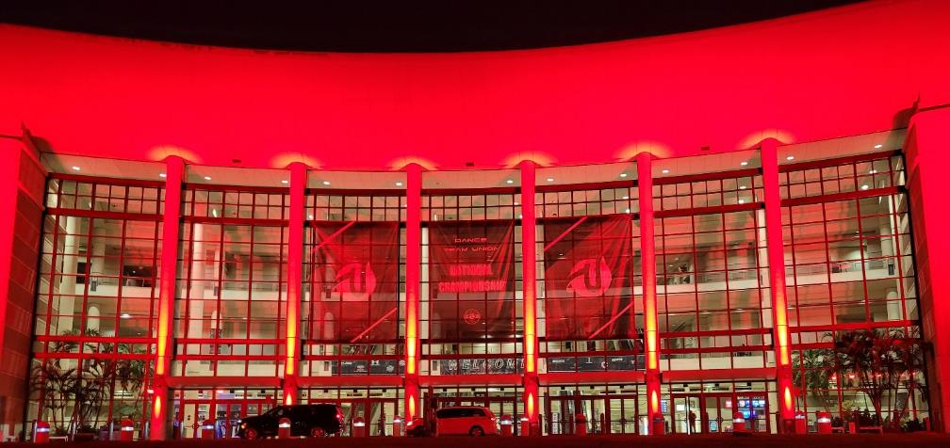
Recent Completed Projects
Notes:
Completed Projects
West Food Service Renovations
Chapin Theater
Wellness Rooms
N-S Flooring
Additional
Campus Diesel Tank Replacements
N-S Smoke Control Upgrades
N-S Access Control Replacement
Campus Remote DMS Upgrades

Slide 7


Current Projects
Campus Dry Sprinkler System Replacement
Campus Air Compressor Upgrades
Campus Exterior Pavilions
Campus Security Guard Booths
Campus Floor Box and Sump Pump Upgrades
N-S Meeting Room Renovations
N-S Restroom Renovations
N-S Exterior Show Power Upgrades
West Bldg Expansion Joint Replacement
Notes:
Provide the types of projects that come from Convention Center division.

Slide 8
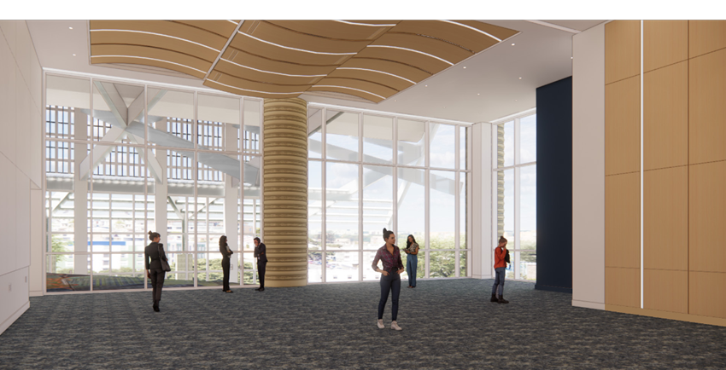
Capital Improvement Program (CIP) Projects
North-South Meeting Room Renovations
  25 Meeting Rooms
  Carpeting and Finishes 22+ Years Old
  Each Between 4,000 sf and 20,000 sf
Restroom Renovations
  92 Restrooms
  Fixtures and Finishes 22+ Years Old
Notes:
Provide the types of projects that come from Convention Center division.

Slide 9
Upcoming Bid Projects
CMAR- West BAS and HVAC Upgrades
Design-Build- N-S Chilled Water System Upgrades
IFB- Campus Elevator/Escalator Modernizations Phase 1A
IFB- N-S Food Service Renovations
IFB- West Access Control System Upgrades
IFB- Campus Wide Coatings Improvements
Notes:
Provide the types of projects that come from Convention Center division.

Slide 10
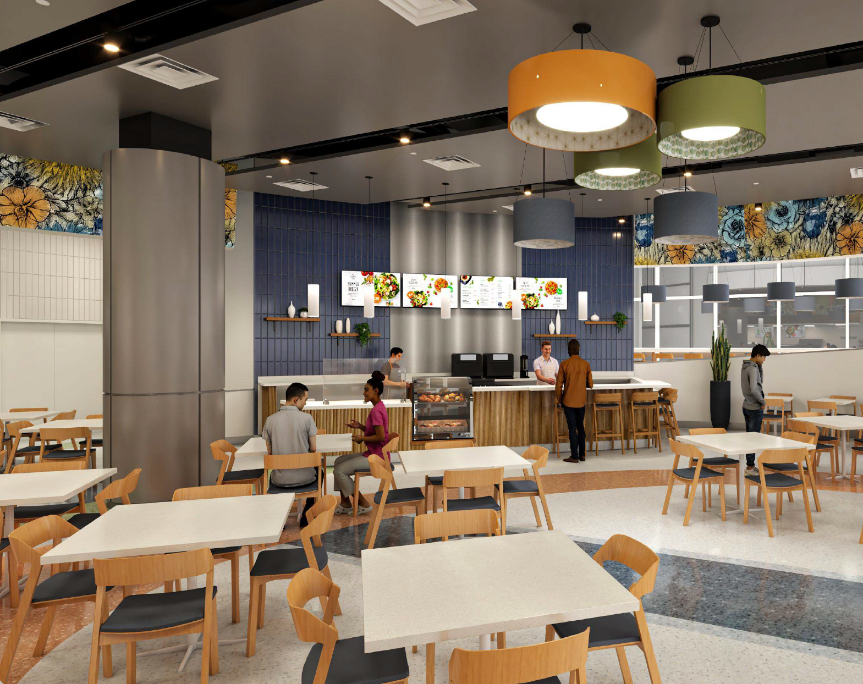
Capital Improvement Program (CIP) Projects
N-S Food Service Renovations
  4 Food Courts
  2 Restaurants
  1 Lounge

Slide 11
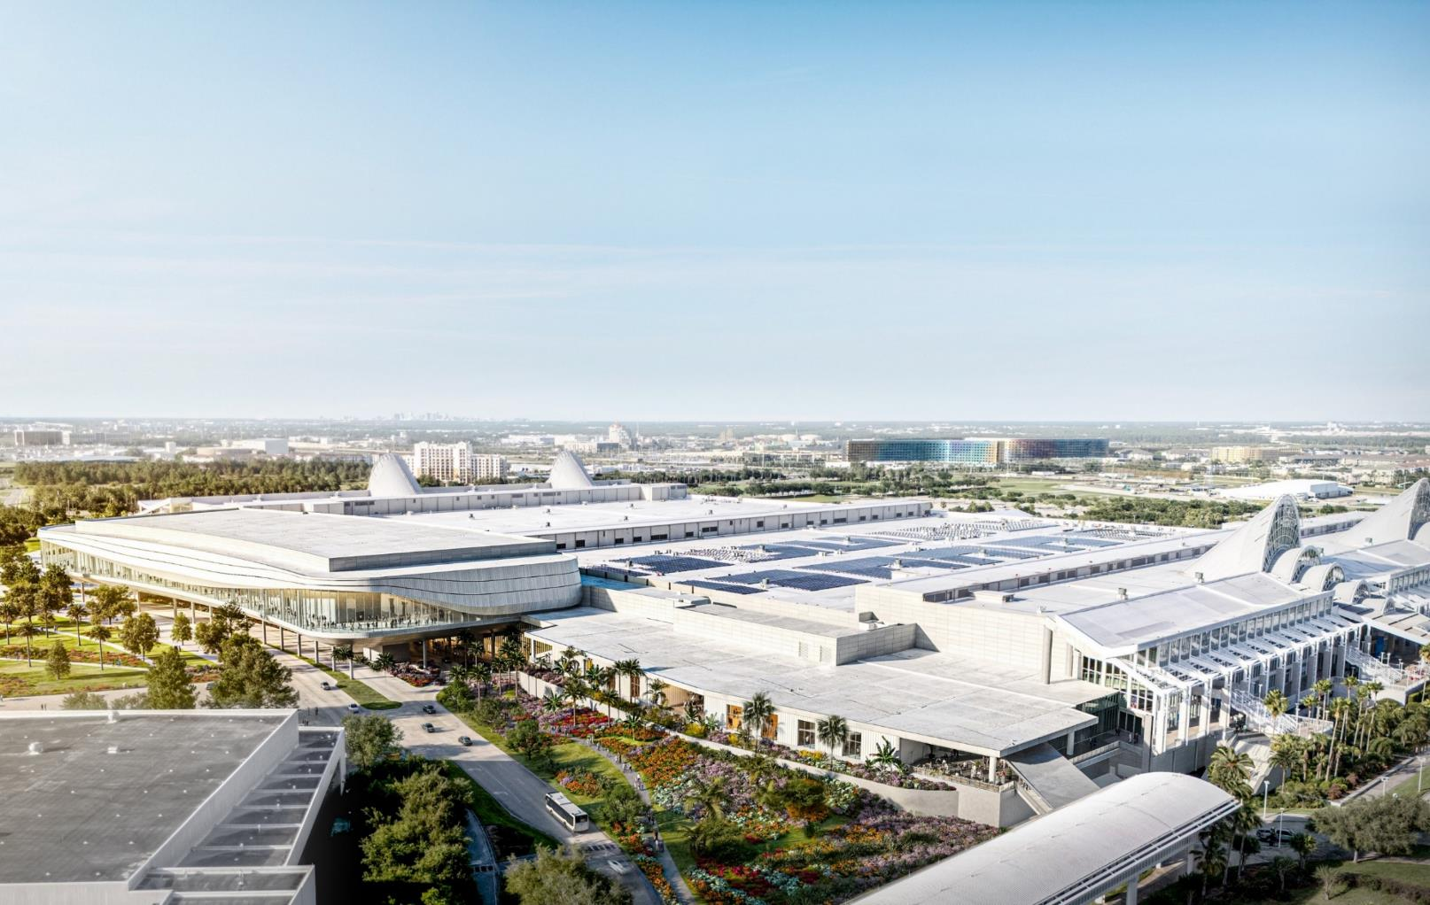
Capital Improvement Program (CIP) Projects
Grand Concourse Expansion
Enhanced Connectivity
Dedicated Ballroom
Additional Meeting Rooms
Flexible Space for Capacity
Construction Begins March 2026
Slated to Open Late 2029
Notes:
Provide the types of projects that come from Convention Center division.

Slide 12
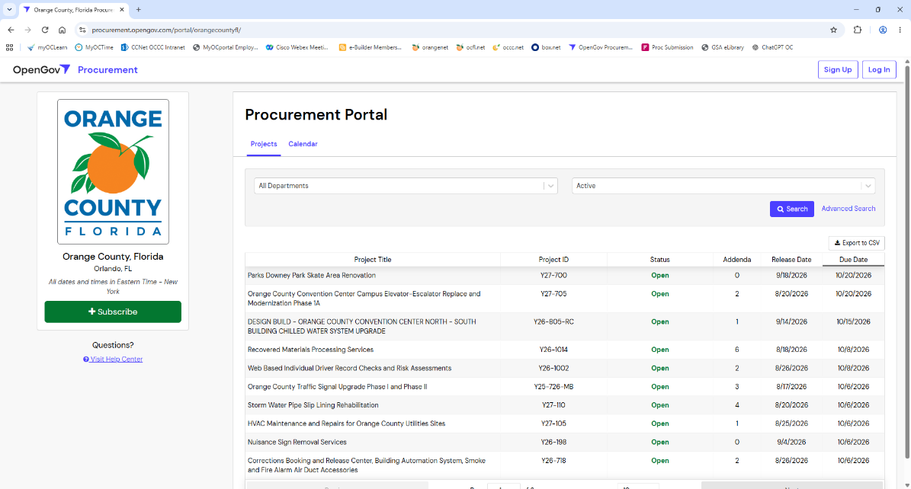
Procurement and Bidding
Project Types
Bid Process
OpenGov
https://www.ocfl.net/
Notes:
Provide the types of projects that come from Convention Center division.

Slide 13

THANK YOU!
Notes:
Thank you. We will take questions at this time.

