Slide 1

Board Orientation 2023

Slide 2
Agenda
What is ABC?
Governance & Structure
Purpose
What is a Board?
What does a Board do?
Fiduciary Duties
Board Responsibilities
Expectations
Operations
Finance
Final Thoughts

Slide 3
What is ABC?
ABC is a 501(c)(6) not-for-profit trade association that is chartered as a chapter of the National ABC association.

Slide 4
ABC History
Founded in 1950 in Baltimore
Principles of Merit Shop
First chapter - Chesapeake Shores - chartered in 1957

Slide 5
Governance & Structure
National
State
Chapters
Notes:
ABC now has 68 Chapters, 22,000 members
The National Board is made up of reps from each of those chapters – approx. 170 members.
Some states have multiple chapters and state organizations – Florida is one of them.
ABC of Florida board’s is made up reps from each of the Florida Chapters.
How many Chapters does Florida Have?

Slide 6
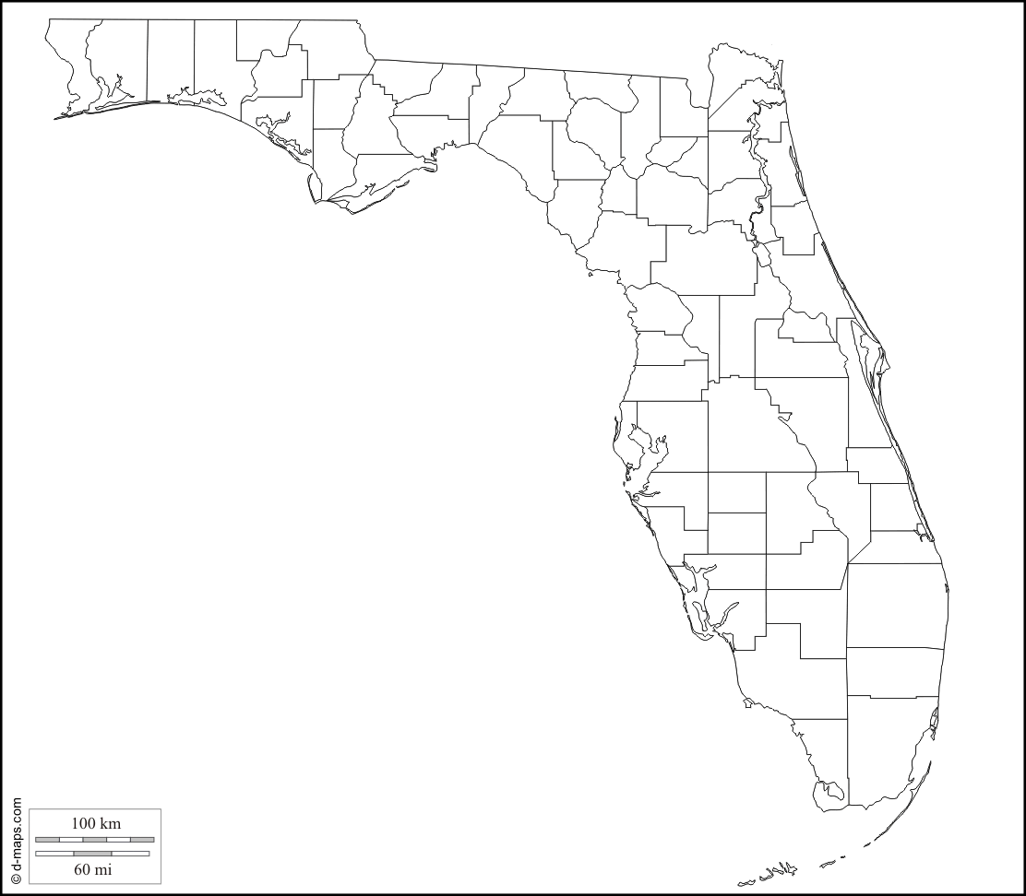
Central Florida Chapter
VOLUSIA
SEMINOLE
LAKE
ORANGE
OSCEOLA
Notes:
Since we are celebrating our 50th Anniversary this year – in what year was the Central Florida Chapter ABC was chartered? 1973
The Central Florida Chapter serves the 5 counties its members perform-in and manage work from: Volusia, Seminole, Lake, Orange, and Osceola.

Slide 7
ABC Central Florida Board Structure
Officers
Directors
  – At Large members (12)
  – Associate/Supplier members (4)
  – Owners (2)
  – Outlying county members
  Advisor to the Board
  – General Counsel
Notes:
CFC ABC has 25 individual members serving on its board of directors which represents all areas of membership; General Contractors, Subcontractors, Supplies, and Associate Members.
There are numerous annual committees, and there are 9 staff positions to service ABC member needs.

Slide 8
ABC CF Board Structure
Officers / Executive Committee
  Chair
  Chair-elect
  Vice Chair
  Treasurer
  Immediate Past Chair

Slide 9
ABC CF Board Office Terms
Board of Directors
Executive Committee one-year term of office
Directors three-year terms, staggered
Four at-large Directors 1 year remaining
Four at-large Directors 2 years remaining
Four at-large Directors 3 years remaining
Two Supplier/Associate Directors 3 years remaining
Two Supplier/Associate Directors 1 year remaining
One Director may also be appointed by the Board from each Outlying County
(Brevard, Lake, Polk, Volusia, and Osceola Counties); to serve annual terms
Up to two Owner Directors may be appointed to serve an annual term

Slide 10
The Board – Staff Relationship
Two Partners, One Team
The Board focuses on governance, direction and vision based on mission
The President & CEO manages day-to-day operations within the context of the Board’s direction
This partnership allows the organization to achieve its goals, avoids micro-management of the present and over-taxing of the volunteer leaders.
Notes:
Two Partners, One Team
The Board focuses on governance, direction and vision based on mission
The President & CEO manages day-to-day operations within the context of the Board’s direction
This partnership allows the organization to achieve its goals, avoids micro-management of the present and ovr-taxing of the volunteer leaders.

Slide 11
The Board Dream Team
Knowledge & experience
Balanced membership
Think strategically
Set expectations for success
Hold each other accountable
Visible leaders

Slide 12

Notes:
Let’s talk Purpose

Slide 13

Purpose of ABC
Develop and protect
Foster principles
  merit shop
  open competition
  free enterprise
Promote education
Promote Code of Ethics
Notes:
Develop and protect the construction industry
Foster principles of merit shop, open competition and free enterprise
Promote & encourage continuing education, apprenticeship and other training programs for management and crafts in the construction industry
Promote a CODE OF ETHICS for the construction Industry
ABC’s goal, is not only to be the voice of the construction industry, but to provide resources to help the industry deliver construction services that are high quality, safe, on time, and on budget.

Slide 14
“The Construction Association of Choice”
Helping our members
develop people, win work
and perform that work safely, ethically, profitably
for the betterment of the communities
where we work and live.

Slide 15
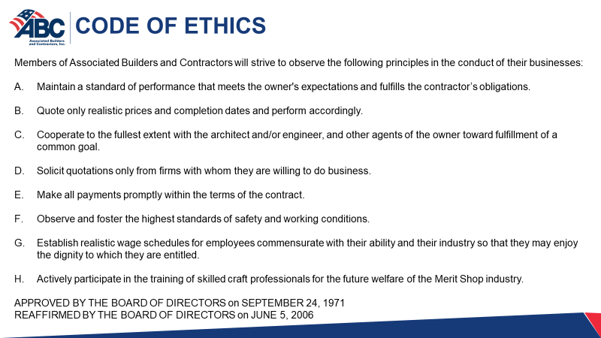
ABC National

Slide 16

National Bylaws
abc.org
Notes:
To truly understand what ABC is about, ready Article 1 & 3 of the National Bylaws Principles of the Merit Shop and Purpose & Objectives.

Slide 17
What is a Board?
The Board of Directors
governS the association
according to the bylaws

Slide 18

What does a Board do?
  Sets policy
  Sets direction/strategic plan
  Hires President & CEO
  Balanced budget
  Has fiduciary responsibilities
Notes:
Sets policy
Sets direction
Creates the strategic plan
Hires President & CEO
Establishes a balanced budget
Has fiduciary responsibility

Slide 19

Fiduciary Duties

Slide 20
Fiduciary Duties
Care
Loyalty
Obedience

Slide 21

Duty of Care
Staying informed
Trusting staff
Active in organizational planning and
  decision-making
Exercise reasonable care in making decisions for the organization
Loving & caring for ABC
Notes:
Board members staying informed about the operations of the organization and asking appropriate questions.
Trusting the staff and Chapter President to lead the organization with little oversight.
Be active in organizational planning & decision making
Reasonable care in making decision for the organization
Really loving ABC!!!

Slide 22

Duty of Loyalty
Always act in the best interests of the organization.
Never use information gained through your position for personal gain.
Support other Board members regardless of the outcome of a decision.
Avoid conflicts of interest or the appearance of conflicts.
Follow ABC’s ethics policies.
Notes:
Showing undivided allegiance to the Chapter’s welfare. - always act in the best interests of the organization
Never use information gained through your position for personal gain.
Support other Board members regardless of the outcome of a decision.
Avoid conflicts of interest or the appearance of conflicts.
Follow ABC’s ethics policies.

Slide 23

Duty of Obedience
Dedicated and knowledgeable to ABC’s mission and goals.
Make sure ABC is abiding all laws and regulations.
Notes:
A board member must be dedicated and knowledgeable to ABC’s mission and goals.
Make sure ABC is abiding all laws and regulations.
Do you have a clear understanding of our Chapter’s Mission?

Slide 24
Duties - Follow the Law & Rules
  Federal and State laws
  Chapter Bylaws
  Policies and procedures
  Follow confidentiality policies
Anti-trust policy
Anti-discrimination policy
Conflict of interest policy
Whistle Blower policy
Document retention policy
Legal advice should not be ignored

Slide 25

Board of Directors’ Responsibilities

Slide 26

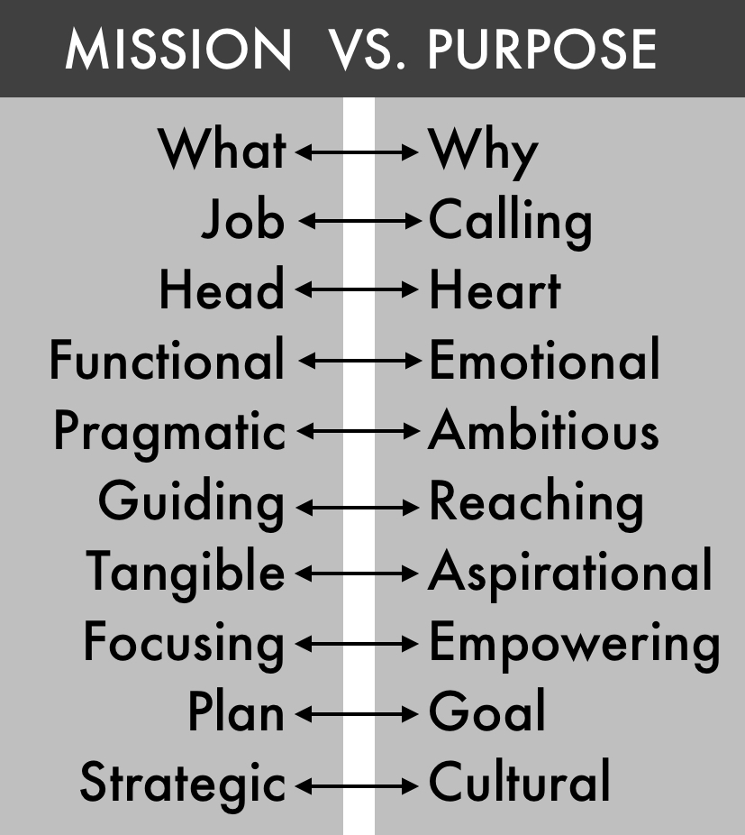
Mission vs. Purpose
Notes:
Know your mission

Slide 27


Your Mission Statements
National Mission Statement
  ABC will continually strive to be the leading voice promoting free enterprise within the construction industry. ABC will promote and defend the merit shop philosophy. This philosophy encourages open competition and a free-enterprise approach to construction based solely on merit, regardless of labor affiliation.
Your Chapter’s Mission Statement
  …

Slide 28
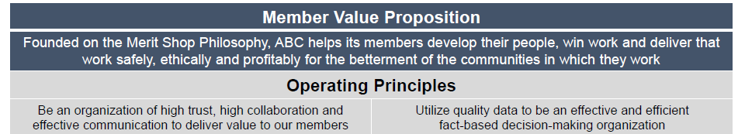
Strategic Plan
Health & Safety
Political Advocacy
Workforce
Membership Growth

Slide 29
Provide Proper Financial Oversight

Slide 30
Establish Financial Controls & Oversight
Day-to-day accounting and financial decisions - President
Framework - Board
  Separation of Duties
  Signatures and Authorizations
  Good-Governance Policies
    Conflict of Interest policy
    Document retention policy
    Whistle Blower policy
  Annual Budget
  Cash Flow and Budgeted vs. Actual Expenses and Income
Notes:
Provide Proper Financial Oversight
While day-to-day accounting and financial decisions are the responsibility of the Chapter President, the Board must establish the framework in which the President operates such as:
Separation of Duties
Signatures and Authorizations
Good-Governance Policies
Conflict of Interest policy
Document retention policy
Whistle Blower policy
Annual Budget
Cash Flow and Budgeted vs. Actual Expenses and Income

Slide 31
Ensure Adequate Resources

Slide 32

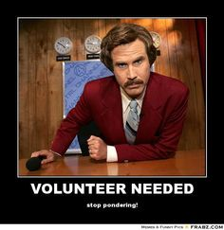
Adequate Resources
Notes:
What is the #1 reason that you volunteer with the Chapter?

Slide 33
Motivations: Why do People Volunteer?
96% To make a contribution
74% To use skills/experiences
64% Personally affected by cause/effort
48% Explore my own strengths
48% To Network
47% Friends volunteer/fun
23% Improve job opportunities
Notes:
Motivations: Why do People Volutneer?
96% To make a contribution
74% To use skills/experiences
64% Personally affected by cause/effort
48% Explore my own strengths
48% To Network
47% Friends volunteer/fun
23% Improve job opportunities
What are some ways that ABC members can volunteer?
Who can name the current ABC Committees for 2023?

Slide 34

Ensure Legal and Ethical Integrity

Slide 35
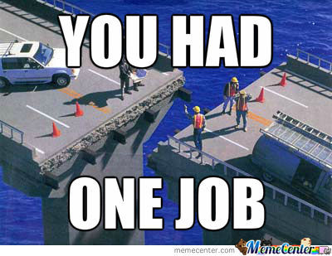
Ensure Effective Organizational Planning

Slide 36
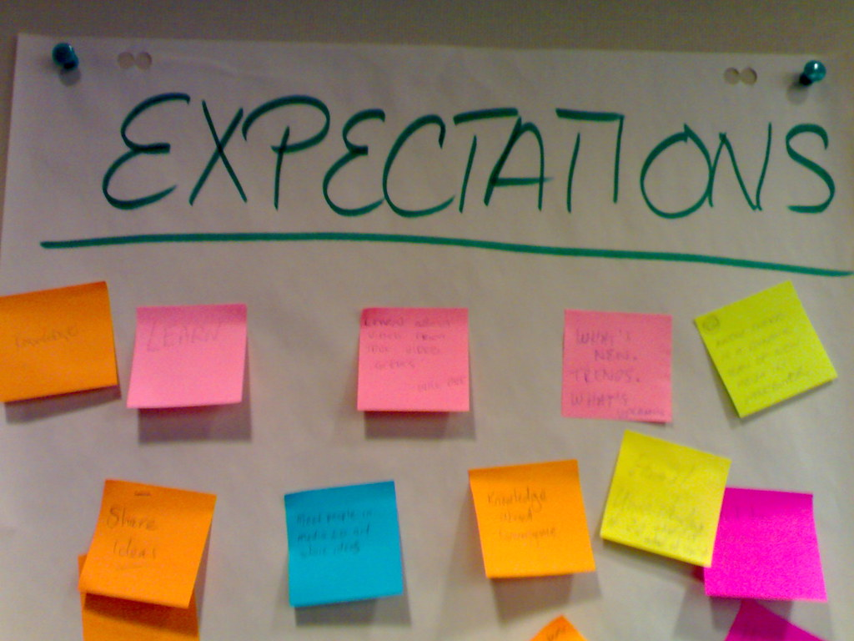

Expectations of
Individual Board Members
2023

Slide 37
Accountability breeds response-ability
– Stephen R. Covey

Slide 38
Accountability is critical for achieving winning results.
Responsibilities are in place
for accountability.

Slide 39
2023 Expectations | Leadership
Attend all scheduled board meetings
  Less than 3 absences
Review materials prior to meetings
Respect peers
Always act for the good of ABC
Positive & supportive
Notes:
minimum of 8 out of 10 scheduled Board meetings - maximum of 2 of those meetings can be via Zoom
To come prepared to discuss the issues and business to be addressed at scheduled meetings, having read the agenda and all background material relevant to the topics at hand.
To work with and respect the opinions of my peers who service this board, and to leave my personal prejudices out of all board discussions.
To always act for the good of ABC Central Florida.
To represent ABC Central Florida in a positive and supportive manner at all times and in all places.

Slide 40
2023 Expectations | Advocacy
Chapter PAC
Free Enterprise Alliance
Trimmer Construction Education Foundation
Attend LegCon or Planning Conference
National PAC (encouraged)
Notes:
Contribute to Central Florida Chapter ABC PAC.*
Annually contribute to the Free Enterprise Alliance.*
Annually contribute to the Trimmer Construction Education Fund.
one ABC of Florida LegCon and one ABC of Florida Planning Conference within three-year term
To encourage members of the ownership/management team in my company to contribute to National ABC PAC.*

Slide 41
2023 Expectations | Engagement
Committee participation (not liaison)
Company committee participation
Attend 2 out 4 Major Chapter Events
Attend ABC National Convention or ABC National Legislative Conference
Notes:
Actively serve on a committee
or secure active participation on a committee from other employees in company
I will annually attend at least 2 out of 4 major Central Florida Chapter events
including the EIC Awards Banquet, the GC Connect, the Technology and Innovation Conference, and the Expo.
To attend either the ABC National Convention or the ABC National Legislative Conference at least once during my three-year term.

Slide 42
2023 Expectations | Mission Support
New member recruitment (2)
Retention effort
VIP Sponsorship or equivalent
Notes:
Assist in the recruiting 2 members with at least one being a contractor member
I will annually call or contact at least one “at risk” member and successfully retain them, if possible, to the best of my ability
Annually participate in the VIP Sponsorship program or comparable sponsorship

Slide 43
What’s our Purpose?

Slide 44
Purpose
ABC helps its members develop people,
win work and deliver that work safely, ethically and profitably for the betterment of the communities where we work and live.

Slide 45
ABC’s Niche
Advocacy
Education
Connectivity
Notes:
CFC ABC has three focused areas of service, which help the members take advantage of all that ABC offers. The areas of focus are: Connections, Advocacy, Education, and Tools to Compete. The chapter focuses on delivering exceptional services in these four categories.

Slide 46
Target Market
Philosophical
Community minded
Believes in free enterprise
Produce a quality service
Have merit shop mentality
Get involved
Gives back to the industry

Slide 47
Strategic Plan

Slide 48

Strategic Planning
Assess where the organization is.
Define goals for where it should go.

Slide 49

Chapter Operations

Slide 50

Committees are the tools boards use to get the work done.

Slide 51
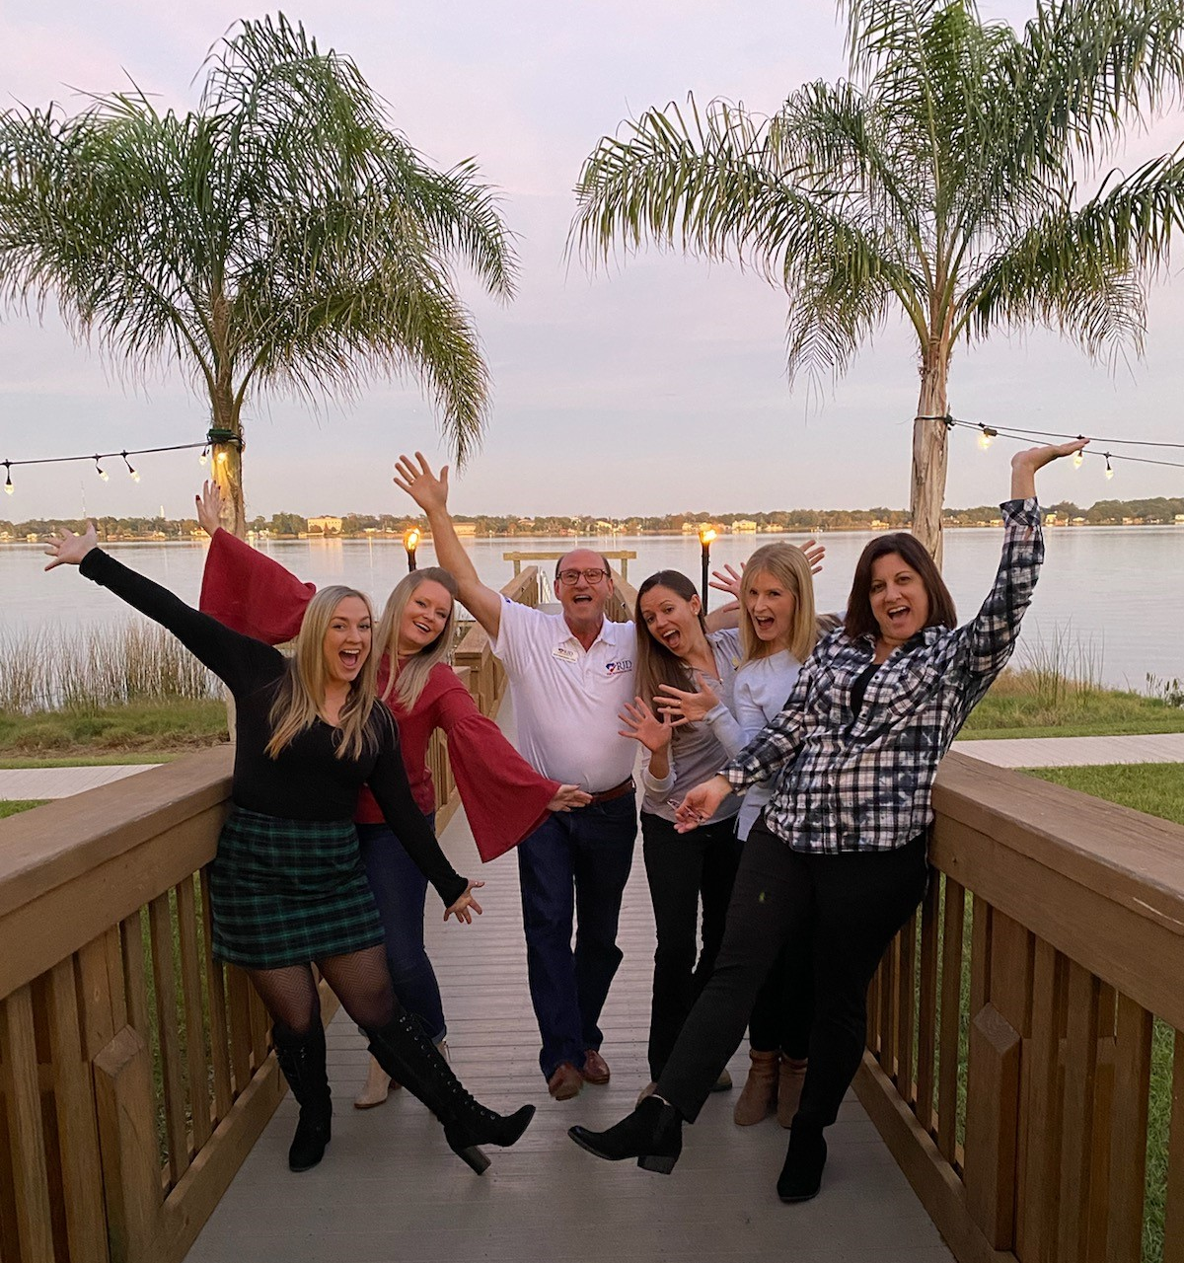
Why Committees are Essential

Slide 52
Types of Committees
Standing Committees
Program & Service Committees
Task Forces

Slide 53
CFC ABC Organizational Chart 2024
Board of Directors
Business Development
GovernmentAffairs
Training & Development
Membership
Governance
Excellence in Construction
Government Affairs
Collegiate Student Chapter
Membership Development
Finance/Audit
Programs
PAC
Outreach
Nominations
ABC of FL
Safety
Special Events
Training &
Development
Workforce
Young Professional

Slide 54
Finances
Income
Expense
Financial Health

Slide 55
Income
Membership dues
Program fees
Sponsorships
Donations
Fund raising activities
Rentals and leasing income
Product sales
Investment income

Slide 56
Program Expenses
State and National dues
Educational program expenses
Meetings expenses
Publication expenses
Cost of goods for resale

Slide 57
General &
Administrative Expenses
Personnel
Travel, Meetings & Conferences
Communications Expense
Occupancy Expenses
Office Expenses
Other G&A Expenses

Slide 58
Other Expenses
Depreciation
Workforce Contributions

Slide 59
Financial Health
Profitability
Assets & Liability
Membership Retention

Slide 60
Profitability
Non-profit is a tax status
Break even or surplus
Balanced budget

Slide 61
Board Member Success

Slide 62
Board Member Success | Final Thoughts
Positive experience
Caretakers of the organization
Speak as a whole
You “represent” the organization
Ask questions as they arise
(due diligence)
Thank you for your service and leadership of ABC.
Notes:
The board experience should be a positive one
The board is the caretaker of the organization
The board speaks as a whole, no board member should have more input or authority than others
Realize you “represent” the organization
Always ask questions as they arise (due diligence)
Thank you for your service and leadership of ABC.

Slide 63


Alone we can do so little; together we can do so much.
- Helen Keller

